Slide 1
QuickestWay
Web app to compare quickest directions from Google, MapQuest and Bing
Project by Alex Quiñones, Dain Lee and Eliram Malachi

Slide 2
QuickestWay

Slide 3
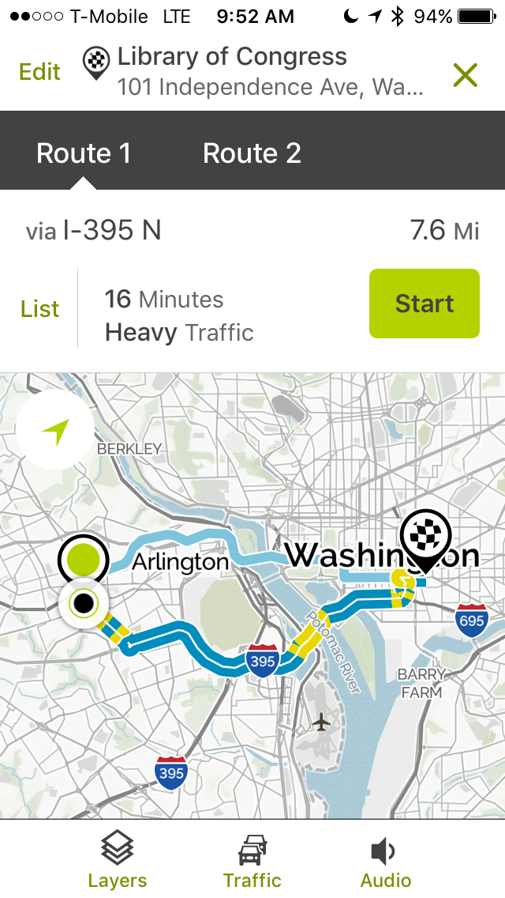
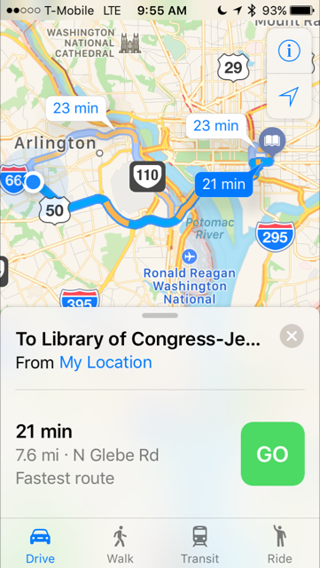
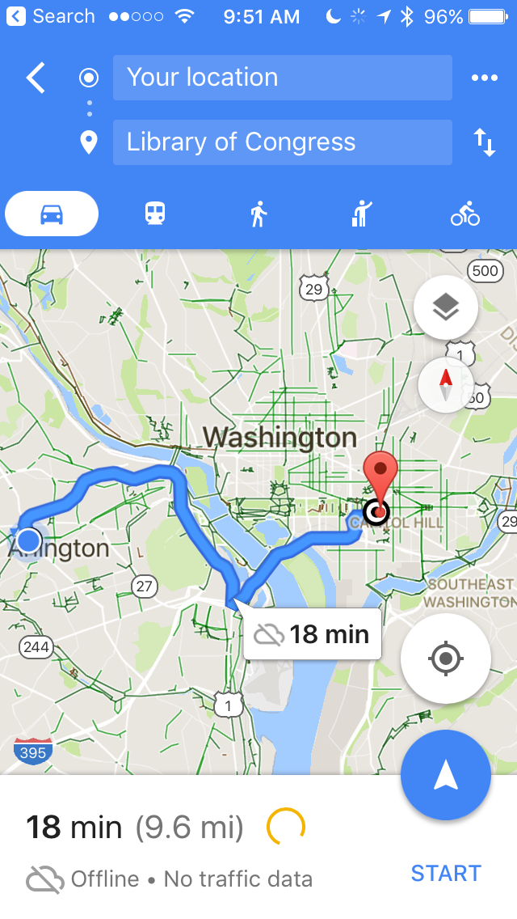
Concept
When searching for directions, mapping services give different routes.

Slide 4
APIs used
Google Maps
Bing Maps
MapQuest

Slide 5
New technology: Animate.CSS
CSS library
Cross-browser animations for text

Slide 6
LAUNCH WEB APP

Slide 7
Areas for further improvement
Standardize completely rendering of output from mapping services
Dynamically load maps
Sort results
Mobile app

